Slide 1
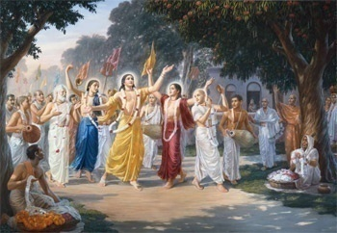
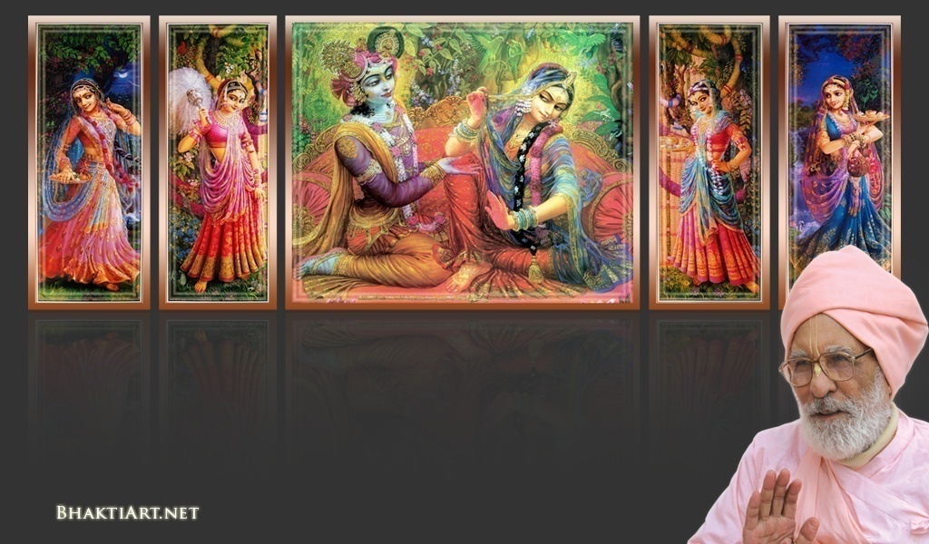
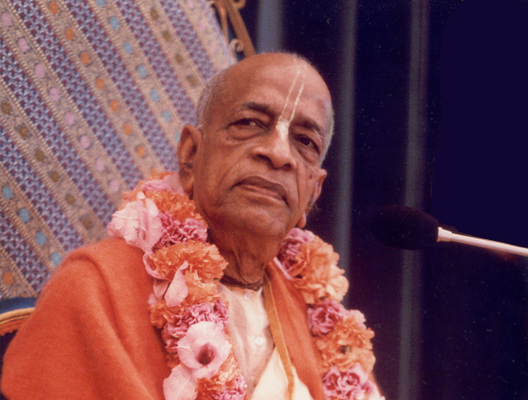
Sri Krsna Caitanya Prabhu Nityananda
Sri Advaita Gadadara Srivasadi
Gaura Bhakta Vrinda
Week 347
Jun 19 2015
Hare Krsna Hare Krsna
Krsna Krsna Hare Hare
Hare Rama Hare Rama
Rama Rama Hare Hare
Gokul Bhajan & Vedic Studies
North Carolina, USA
Notes:
Om Ajnana timirandhasya, jnananjana salakaya
Caksur unmimiltam yena, tasmai sri gurave namah
Namah om vishnu padaya, radhikayah priyatmane
Sri-srimad bhaktivedanta, narayana iti namine
Narayanam gurum vande
Saranam bhakta baandhavam
Gaura manobhishtam purnam
Radha daasyam pradaayakam
Rupaanugaacarya varyam
Rupa manjari preshtakam
Patita paavana baandhava
Yugaacarya naaraayanam
Sri krishna lila kathane sudaksham
Audarya-madhurya gunais ca yuktam
Varam varenyam purusham mahantam
Narayanam tvam sirasa namami
He krishna karuna sindho, dina bandho jagat pate
Gopesha gopika kanta, radha kanta namo ‘stu te
tapta kancana gaurangi, radhe vrindavaneshvari
vrsabhanu sute devi, pranamami hari priye
bhajami radham aravinda netram
smarami radham madhurasmi-tasyam
vadami radham karuna bharardram
tato mam anyasti gatir na kapi
--------------------------
First of all, I pay my koti dandavat pranams to my diksha guru Om vishnupada rupanuga acharya Sri Sri Bhakti Vedanta Narayana Goswami maharaja. My koti dandavat pranams to Sri Sri Bhakti Vedanta Swami Prabhupada, and guru varga.
My humble pranams at the lotus feet of all assembled devotees, vaishnavas and vaishnavis..

Slide 2
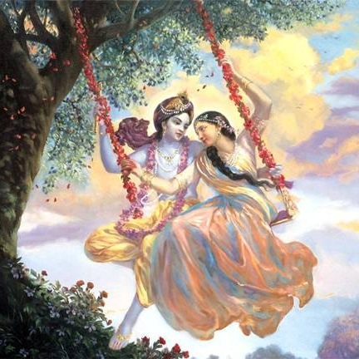
Jaya Rādha Mādhava
Jaya Kunja Vihārī
Jaya Gopī Jana Vallabha
Jaya Giri Vara Dhārī ... (Jaya)
Yaśodā Nandana Vraja Jana Ranjana
Yamunā tīra Vana Cāri ... (Jaya)
[ Hare Krishna Hare Krishna
Krishna Krishna Hare Hare
Hare Rāma Hare Rāma
Rāma Rāma Hare Hare ]

Slide 3
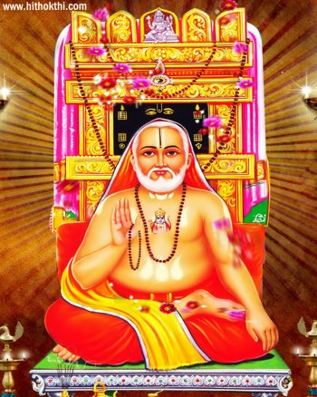
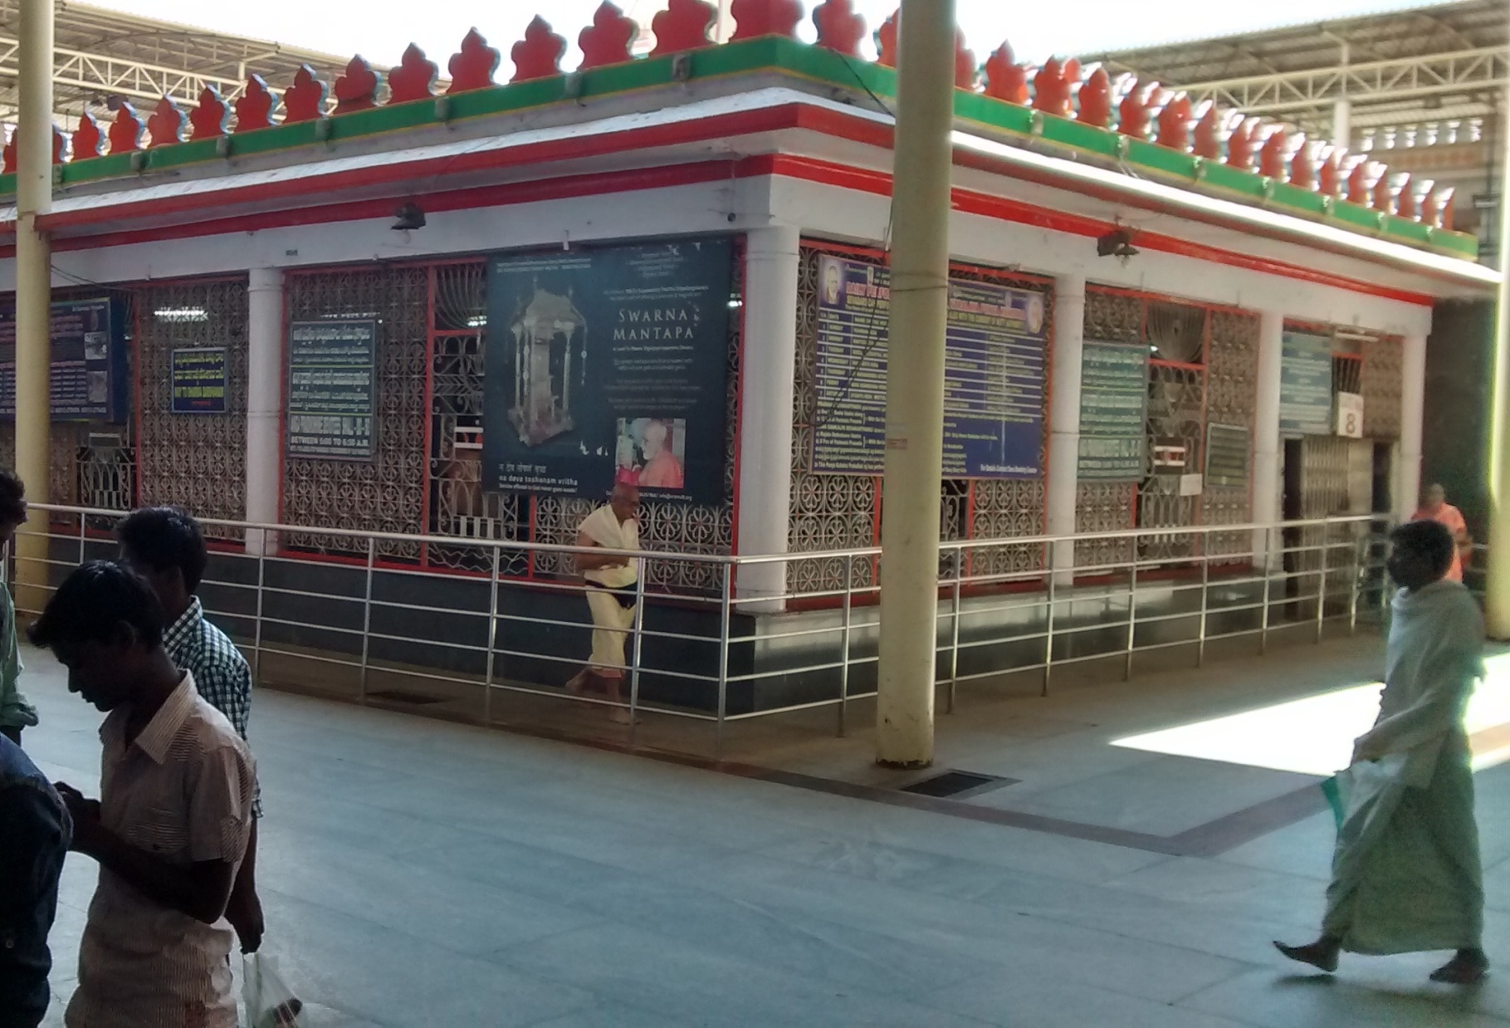
Manthralaya & Sri Raghavendra Swami
Notes:
Last week, we saw the pilgrimage trip to Manthralaya, and also about Sri raghavendra Swami.

Slide 4
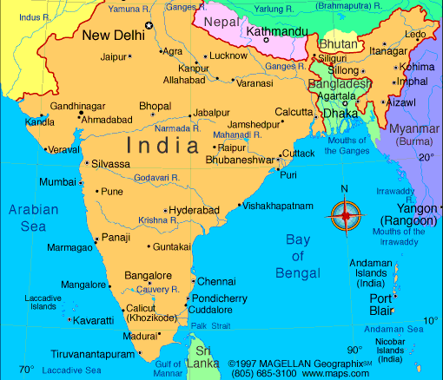
4 Weeks from Feb 23..
Chennai -> Kurdha Rd
Kurdha Rd to Puri
Puri to Calcutta
Calcutta to Nawadwip
Nawadwip to Calcutta
Calcutta to Delhi
Delhi > Aniruddh Prabhu
Aniruddh home to Jaipur
Jaipur to Mathura Vrindavan
Mathura to Pune, Kurdvadi
Kurdvadi to Pandarpur
Pandarpur to Kurdvadi
Kurdvadi to Manthralaya
Manthralaya to Sindhanur
Sindhanur to Kishkintha
Kishkintha to Sindhanur
Sindhanur to Bangalore
Bangalore to Chennai
Chennai to Kanyakumari

Slide 5
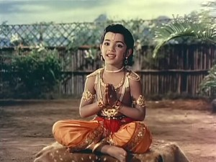
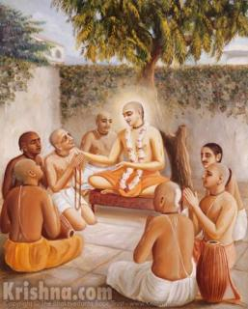
Who is Sri Raghavendra Swami?
Prahlad is also was also Shankukarna, a Devatha, in the Dwapara Yuga.
Notes:
He is none other than Prahlad Maharaj
He also came in Haridas Thakur
Prahlad - Satya Yuga
Haridas Thakura – 1451 – 1530?
Swami Raghavendra – 1595 - 1671

Slide 6
Stages of Devotion
Dhūmāyitā (smoking stage)
Jvalitā
Dīpta (blazing)
Uddīpta (inflamed)
Sūddīpta (intensely inflamed)
Nitya-Siddha-Bhakta – in company of Lord
Notes:
A devotee goes thru several stages.
The word sūddīpta-sāttvika is explained as follows by Śrīla Bhaktisiddhānta Sarasvatī Ṭhākura:
"The Bhakti-rasāmṛta-sindhu mentions eight kinds of transcendental transformations in the bodies of advanced devotees. These are sometimes checked by the devotee, and there are two stages of such checking, technically known as dhūmāyitā and jvalitā. The dhūmāyitā (smoking) stage is exhibited when only one or two transformations are slightly present and it is possible to conceal them. When more than two or three transcendental transformations are manifest and it is still possible to conceal them, although with great difficulty, that stage is called jvalitā (lighted). When four or five symptoms are exhibited, the dīpta (blazing) stage has been reached. When five, six or all eight symptoms are simultaneously manifest, that position is called uddīpta (inflamed). And when all eight symptoms are multiplied a thousand times and are all visible at once, the devotee is in the sūddīpta (intensely inflamed) stage. Nitya-siddha-bhakta indicates the eternally liberated associates of the Lord. Such devotees enjoy the company of the Lord in four relationships—as servant, friend, parent or conjugal lover."

Slide 7
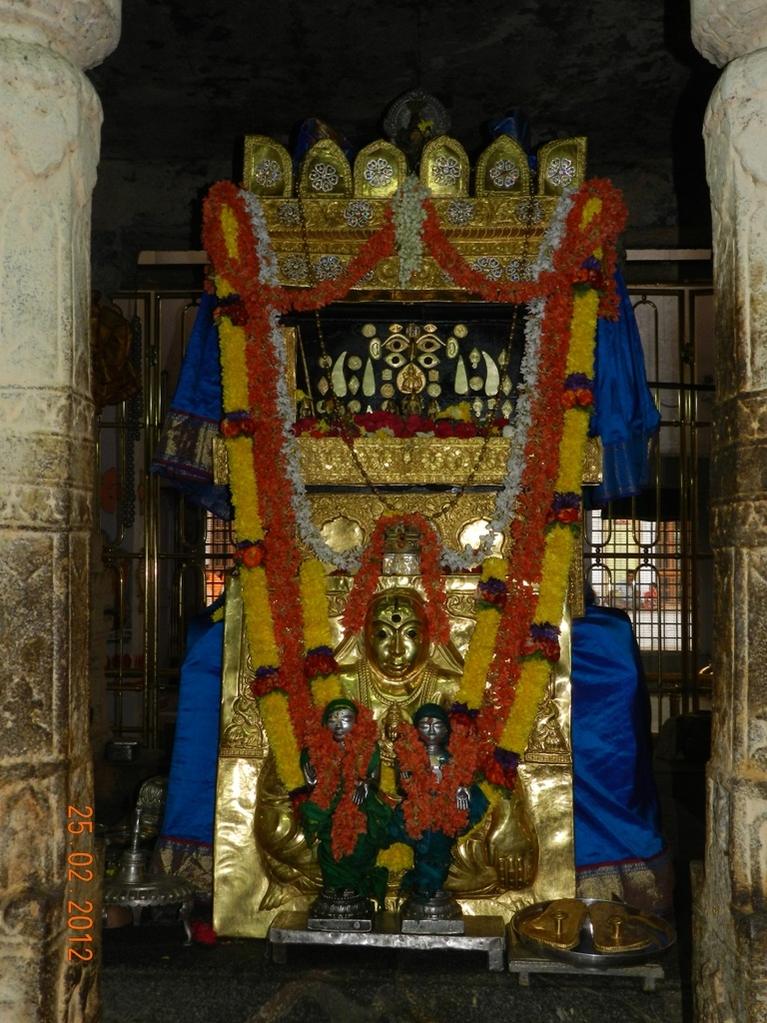
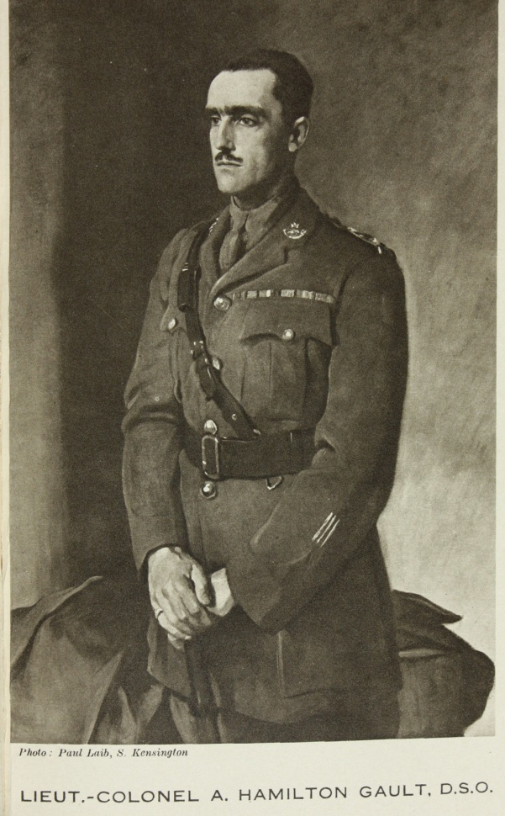
A real incident happened at the time of British in India..
Notes:
British officer
A devotee of Sri Raghavendra
Wanted to See Swami
A brahmin boy came out of the same samadhi
Gave blessing
And then went back inside the samadhi right in front of his own eyes..
Even now people hear him chanting!
78, 200, 400

Slide 8
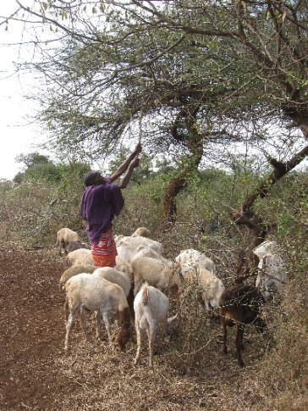
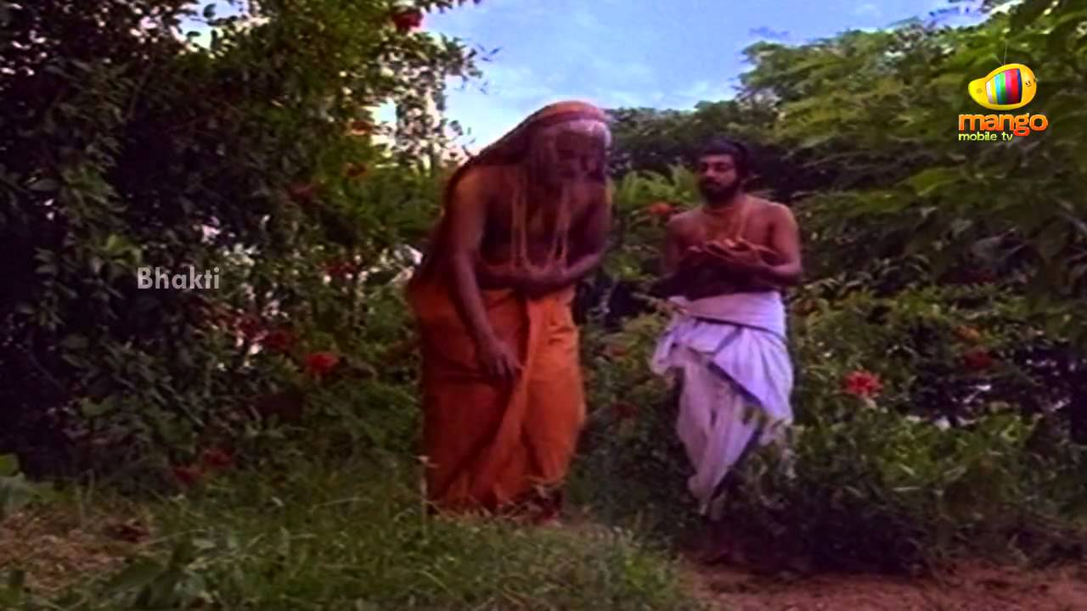
Another incident of a Sheep illiterate Ranger
Notes:
Uppanna!
Illiterate..
Once Raghavendra Swami with his disciples were walking..
Somehow touched in his heart, the boy gave obeisances.
Swami gave the blessing.
‘Whenever you need my help, just think about me! I will help..”

Slide 9
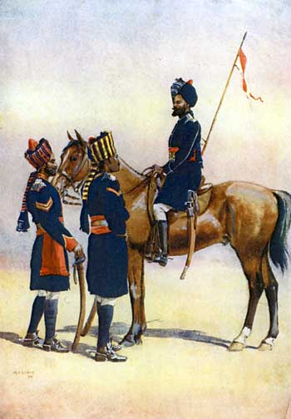
Notes:
Muslim King ADONI visiting
A messenger came on a horse and gave a letter
But it was in the local language. No one could read..
King found this sheep-Rancher
Asked him to read. He said, He does not know anything.
King misunderstood that he refuses his order..
King was about to kill him.
Uppanna prayed to Swami Raghavendra and now he could read all!
King got so happy due to the good news and took him as a DIWAAN in his court.

Slide 10
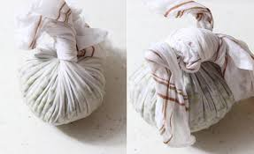
A meat plate from Adoni - the Muslim King !
Notes:
Much after the above incident had occurred; Sri Raghavendra Swami got an opportunity to meet the Nawaab of Adoni face-to-face. The Nawaab, instead of being respectful to him, decided to test his spiritual skills and placed before the Swamiji, a plate of non vegetarian delicacies completely covered with a piece of cloth, in the guise of offering alms.
Per Hindu customs, alms are customarily offered to a visiting saint to seek his blessings. Swamiji took some water from his Kamandala, meditated and sprinkled it on the covered plate, as part of his regular practice of purifying any food before consumption. He then opened the plate. It contained fresh fruits. The Nawaab immediately became remorseful and became an ardent devotee of Swamiji then on. As an apology, he offered to give the Swamiji any amount of land and wealth. While Swamiji refused any such gift for his personal gains, he asked that the land around Manchale (present day Mantralayam), which was part of the Nawab's kingdom, to be handed over to his Matha.
Though the Nawaab of Adoni offered to give him a more fertile region, Sri Raghavendra Swami insisted on the dry and barren region around Mantralayam, on the banks of the Tungabhadra River.
Many years later, he told a devotee that it was the region where King Prahalada had performed his yagnyas to Lord Rama during the Dwapara Yuga and was hence an extremely holy land. Thus the Matha moved to Mantralayam where Sri Raghavendra Swamy continued his spiritual journey. At Mantralayam, Sri Guru Raghavendra encouraged Annadhanam (donation of food) to all devotees. It is a practice that is followed by the Matha to this date and is heavily subsidized by donations.

Slide 11
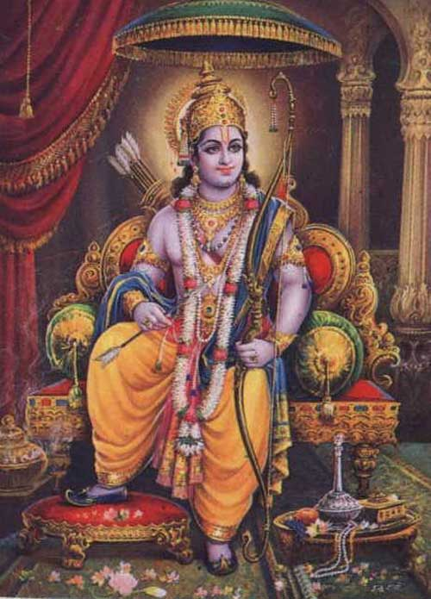
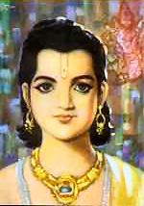
Present Manthralaya is the same place where Prahlad did his Yajna in Dwapar Yuga to Lord Rama
Raghavendra Swami even showed the very same stone where Prahlad sat!
Notes:
Many years later, he told a devotee that it was the region where King Prahalada had performed his yagnyas to Lord Rama during the Dwapara Yuga and was hence an extremely holy land. Thus the Matha moved to Mantralayam where Sri Raghavendra Swamy continued his spiritual journey.
Sri Guru Raghavendra is considered by his devotees to be a reincarnation of Prahalada, the devotee who was saved by Vishnu in his Avatar as Narasimha (see Vaishnava Theology).

Slide 12
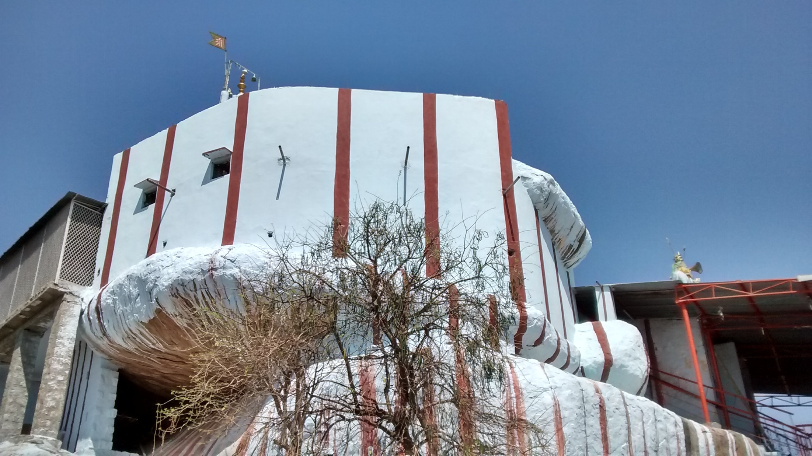
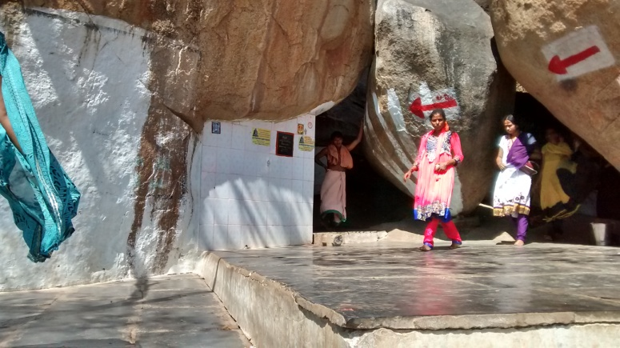
Panchamukhi – the place Sri Raghavendra saw Hanuman in Pancha Mukha form
Notes:
Sri Guru Raghavendra performed penance at a place called Panchamukhi, near Mantralayam, in present day Andhra Pradesh where He received darshan of Hanuman in the form of Sri Panchamukha MukhyaPrana.
We were not allwed to take any picture where it is shown exactly the location in that cave, showing what Mukhas of hanuman were where, etc..

Slide 13
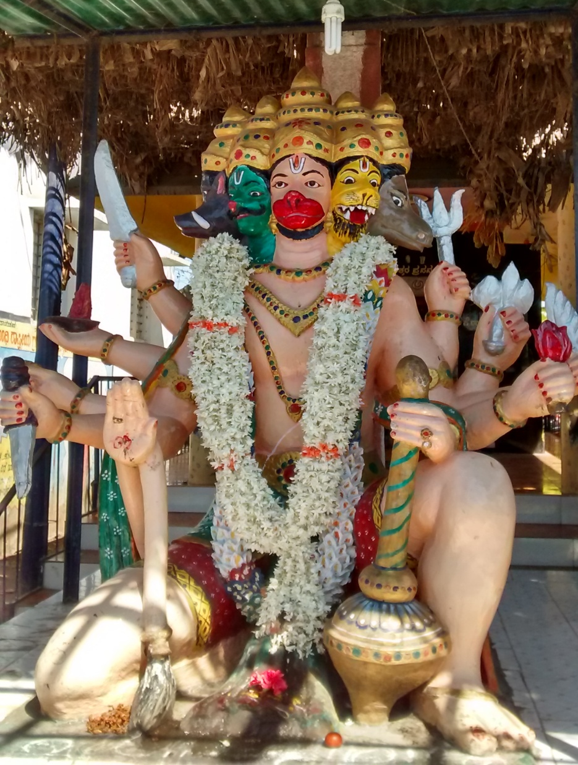
Pancha Mukha Hanuman
Darsan to Swami Raghavendra:
Hanuman,
Hayagriva,
Narasimha,
Garuda and
Varaha
Notes:
Ramayana
Mahir Ravana Story
Hanuman had to take 5 faces to blow a 5 eye lamp in one shot to save Rama & Lakshmana!
Story later..

Slide 14
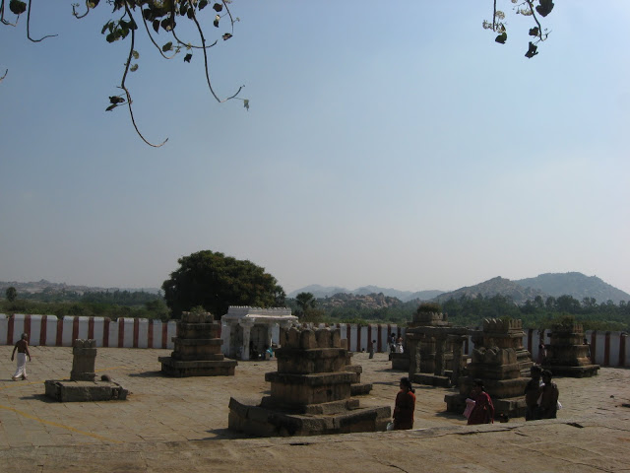
Pilgrimage Memories -8 Nava Vrindavan
Notes:
We were so fortunate and so lucky that we could visit Manthralaya, the holy place for the Madhva Sampradaya.

Slide 15
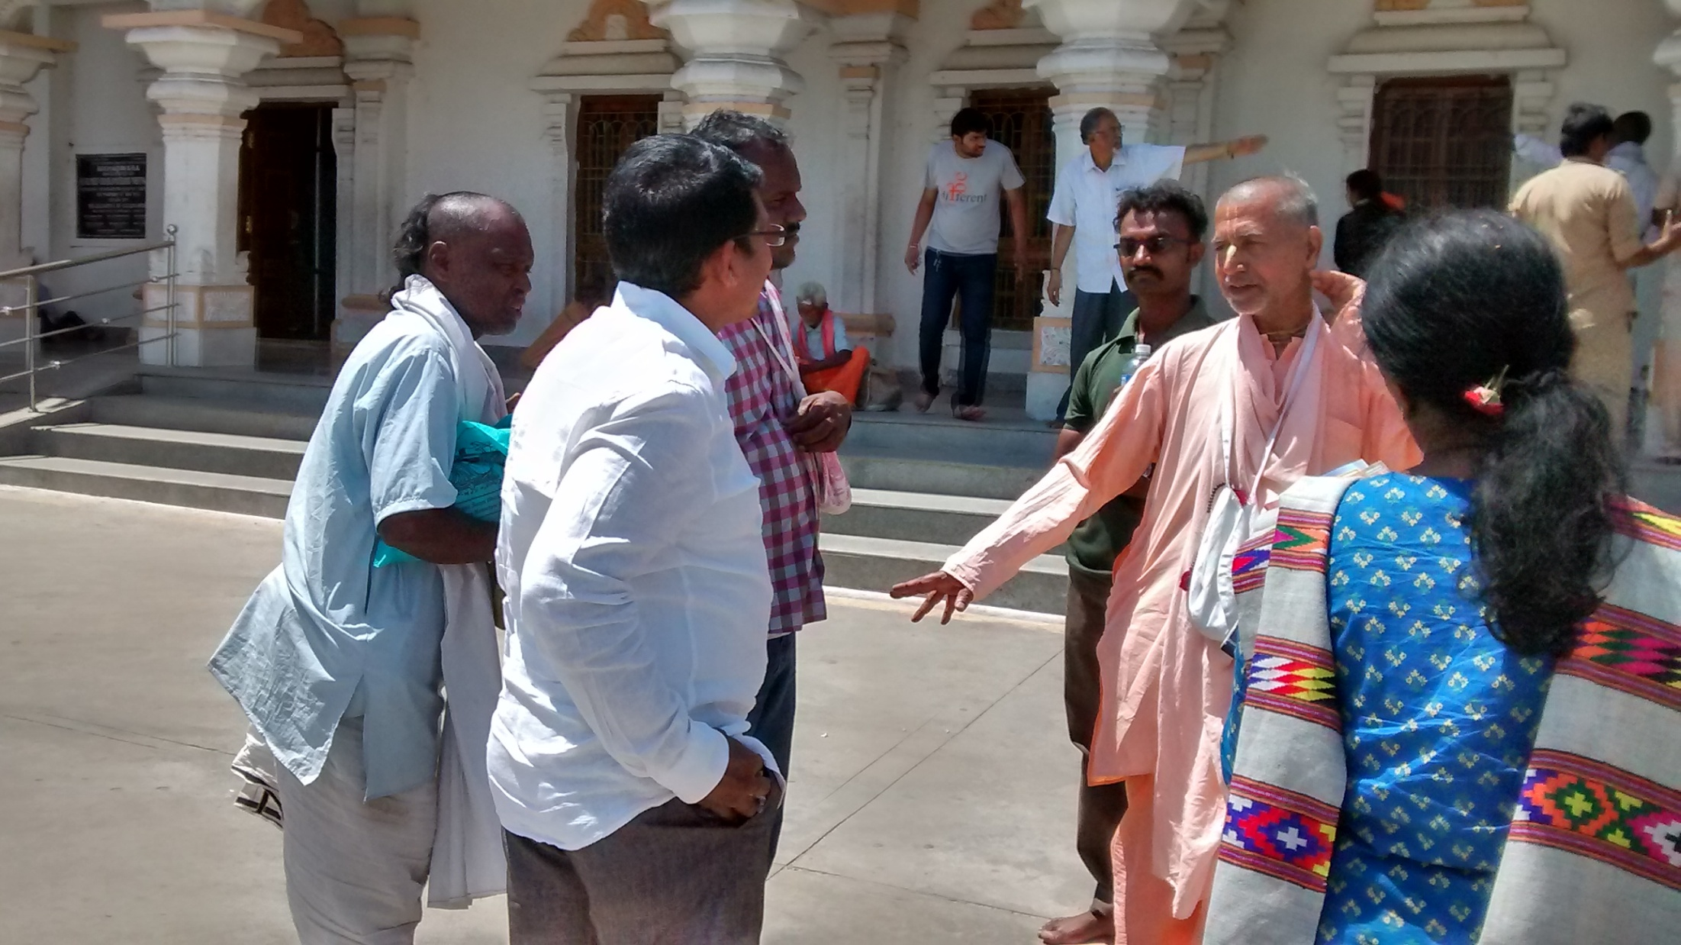
Notes:
When we came out of Manthralaya complex, 4 devotees from no-where offered Dandavats to us.
Our Maharaj smiled!
He instructed the next steps...
Let us go to Sindhanur!
That was where we were supposed to stay for the night..
A place where not even good bath room facility and it is outside!!!
Water problem! Mosquito problem! Food problem!
And Aunty got the continuos caughing problem that went serious!
They prepared special Ayurvedic medicines.. One was a doctor!
None worked!

Slide 16
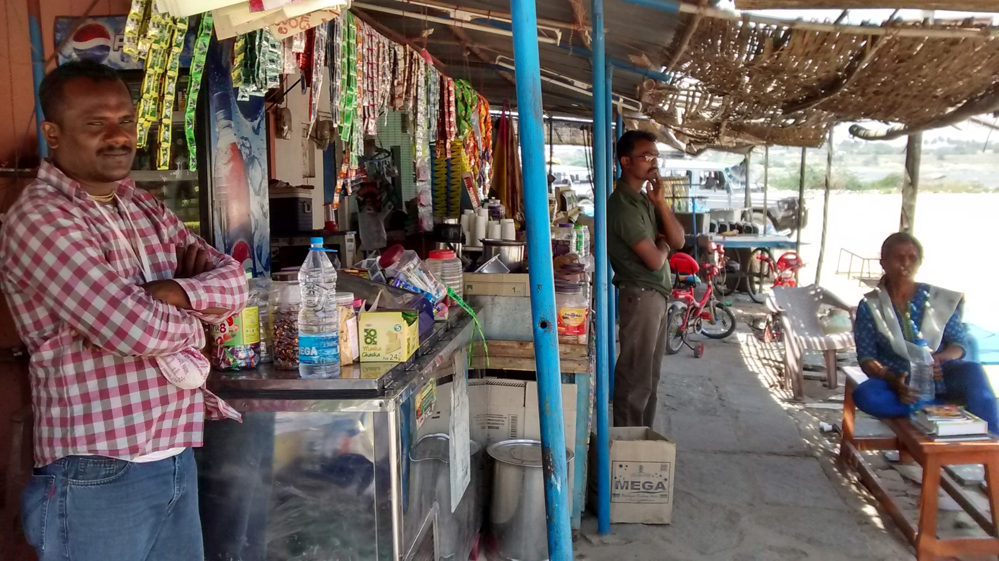
Notes:
Tunkabadra River

Slide 17
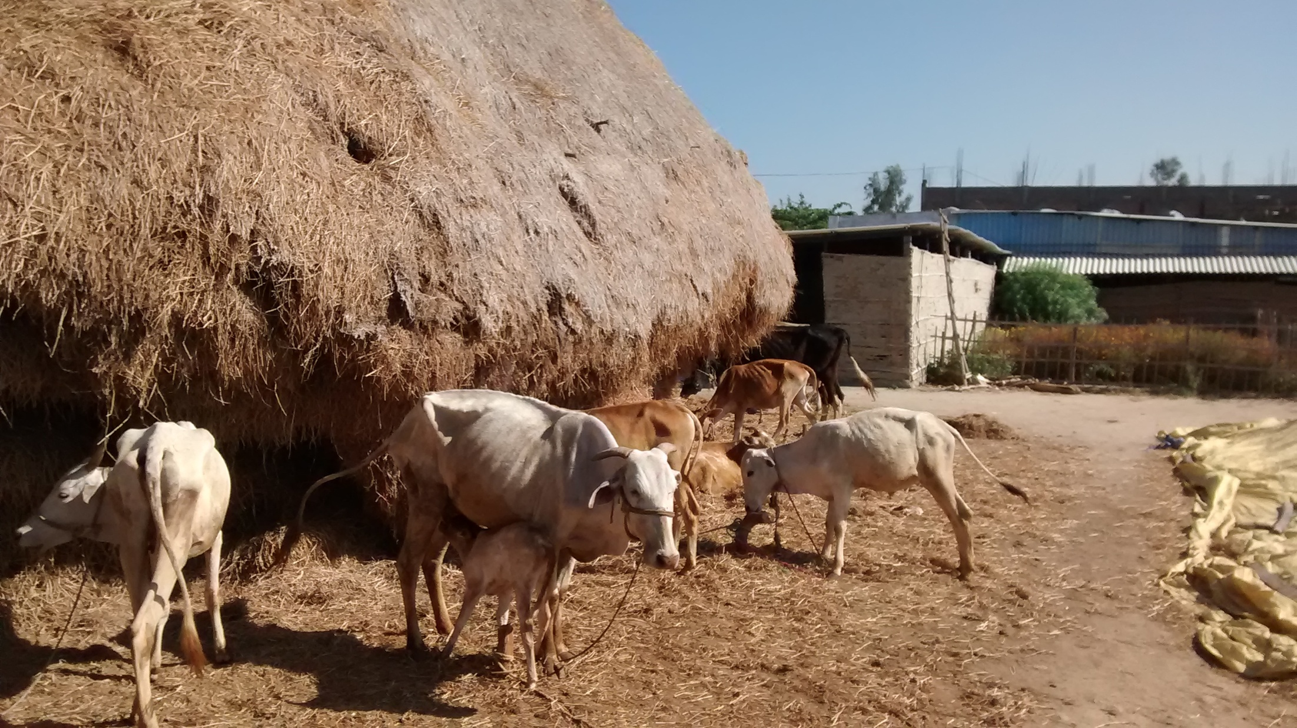

Slide 18
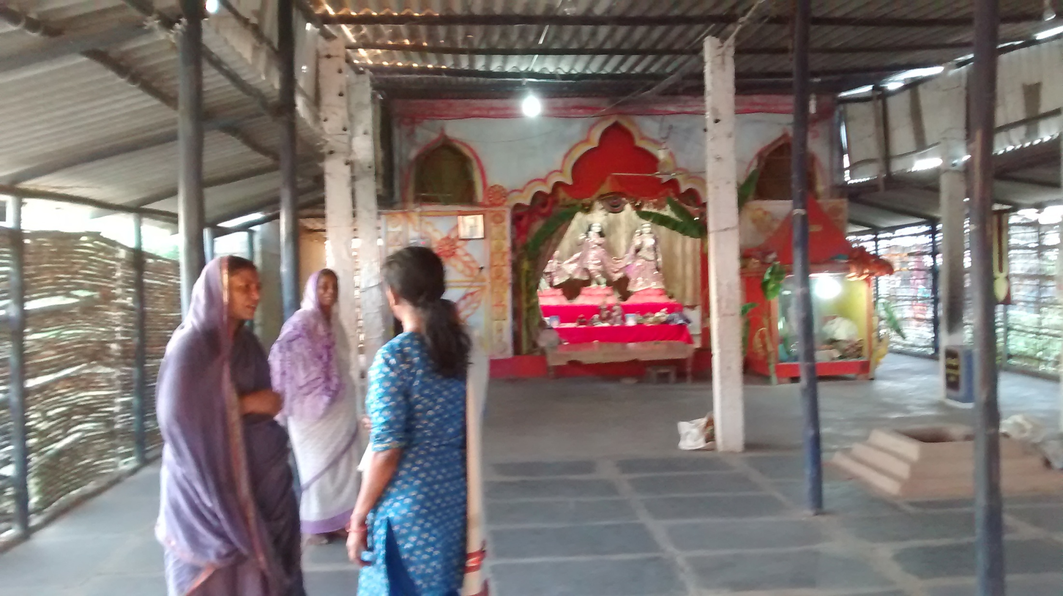

Slide 19
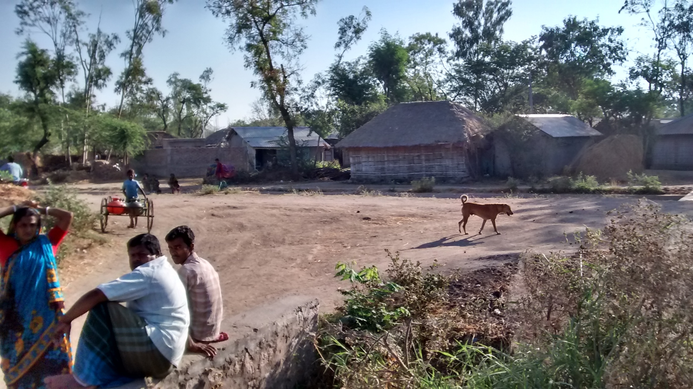

Slide 20
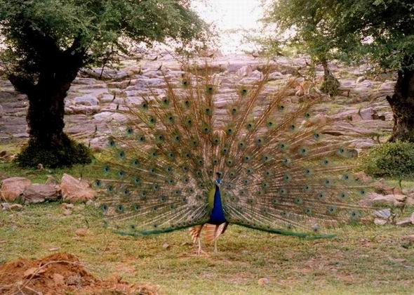
To... Nava-Vrindavan!
Notes:
What is that nava – 9 vrindavans?
It was the very first time I was going to Nava Vrindavan.
I thought there are parts here that is like Vrindavan?
But then was told that it is a place of Samadhis!
Samadhis? You mean burial place?
“Yes, it is the place where 9 of the Acharyas of Madhva sampradaya took Jeeva Samadhi?”
“Jeeva samadhi? – You mean buried alive?” some one asked.
Something splashed in my brain...!
I heard that it was the burial place of nine archaryas...
But they were given samadhi live! – Jeeva Samadhi!

Slide 21
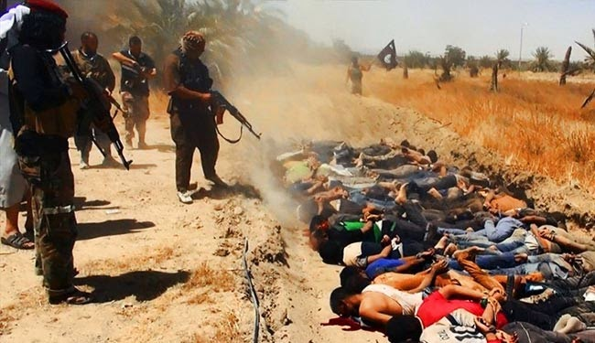
Notes:
Here also you see live and half dead persons are being alive..
But here, they die in agony!
They DO NOT want to die!
But there ....

Slide 22
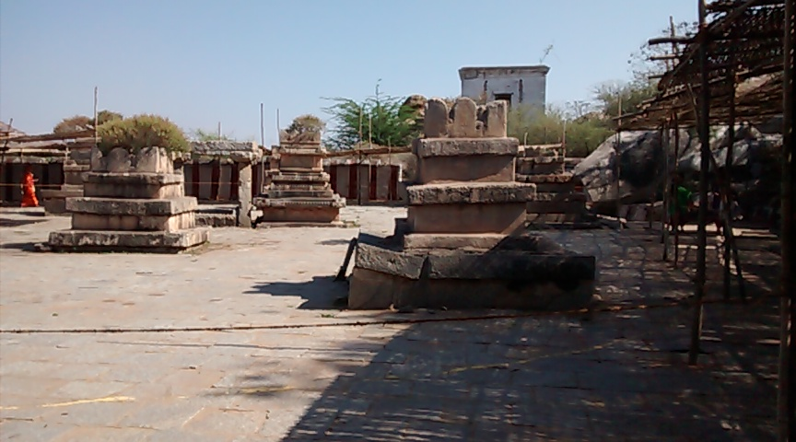
Notes:
No!
It is the place of bliss!
It was not death.. Bliss, eternal bliss.
And it was their CHOICE!
Actually it was not the death at all!
It is their very life!
The demonstrate that we should DIE TO LIVE! DIE TO LIVE!
DIE TO LIVE!

Slide 23
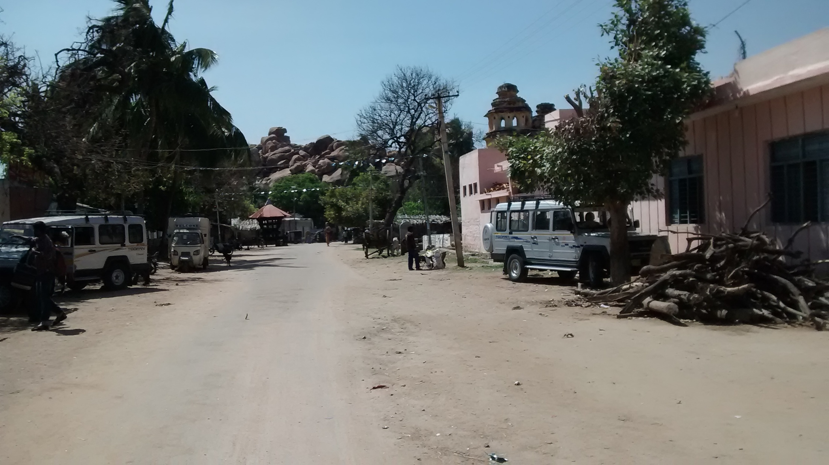
On the way, we stop at a Matha of Sri Raghavendra Swami for our lunch..
Notes:
At Mantralayam, Sri Guru Raghavendra encouraged Annadhanam (donation of food) to all devotees. It is a practice that is followed by the Matha to this date and is heavily subsidized by donations.
This is the Matha.
Our van is standing outside..
This is actually in Kishkintha..
(We will cover it in details next week)

Slide 24
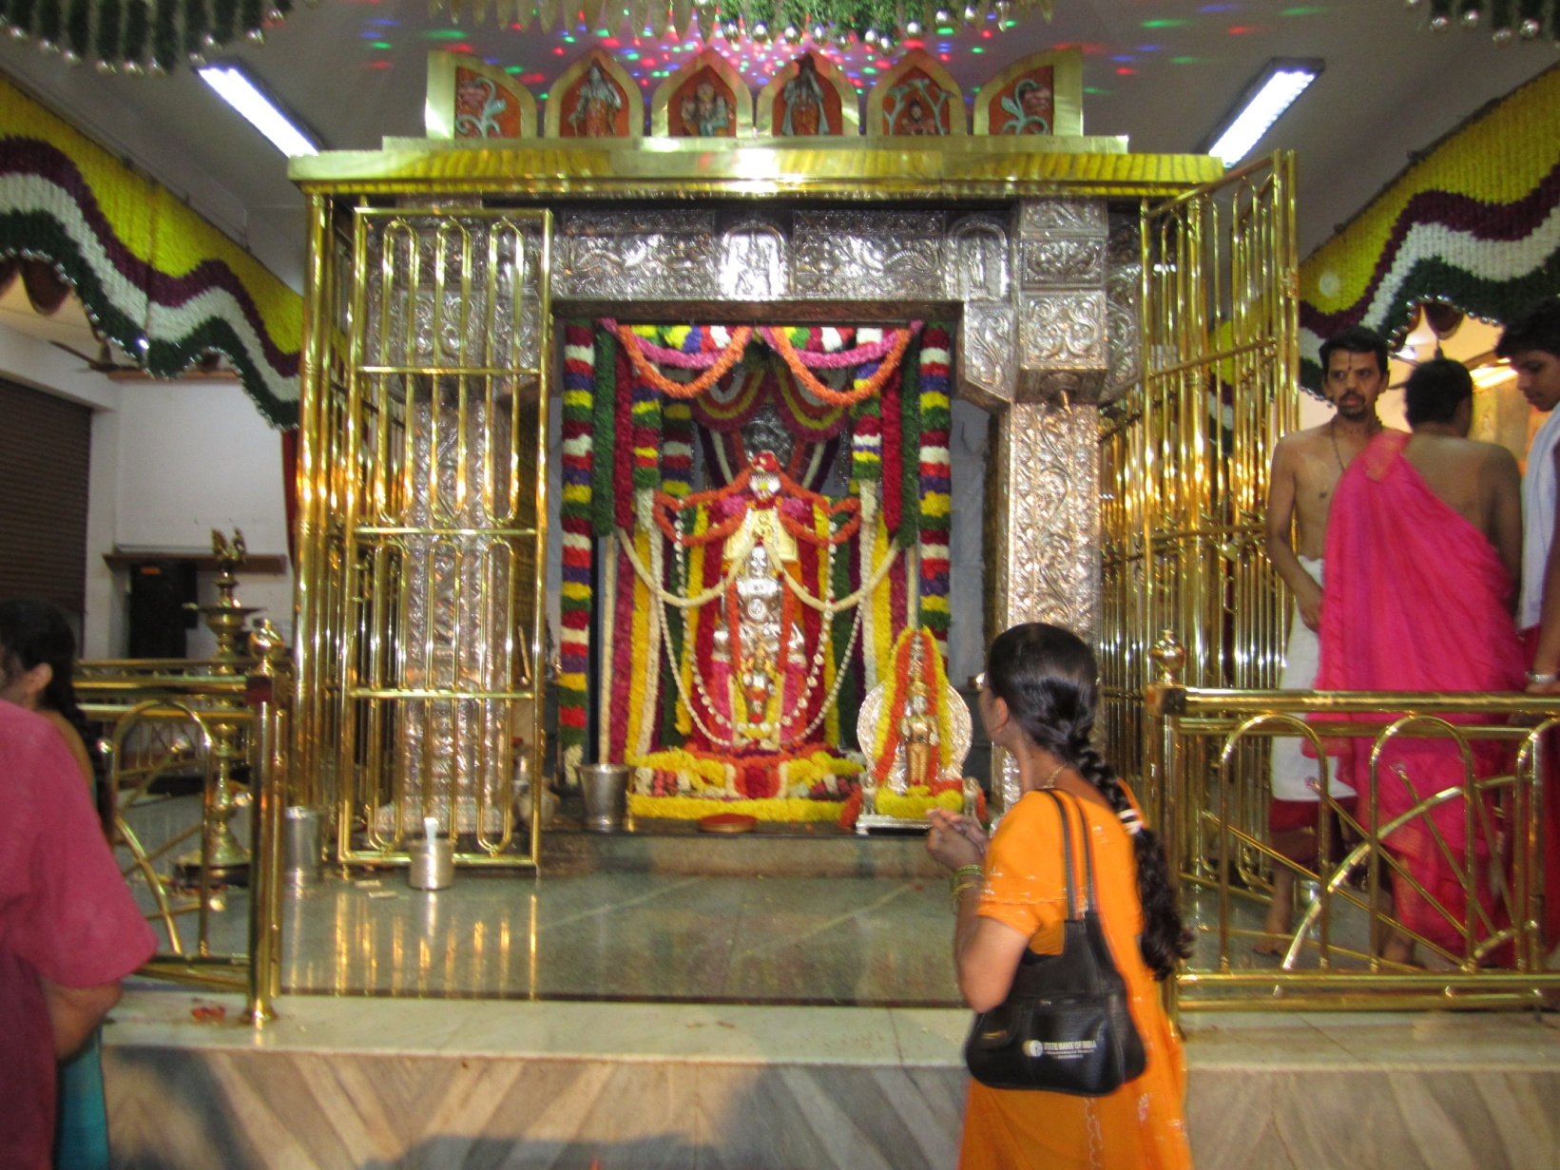
Notes:
Inside :
Pushpa Samadhi of Raghavendra Swami..

Slide 25
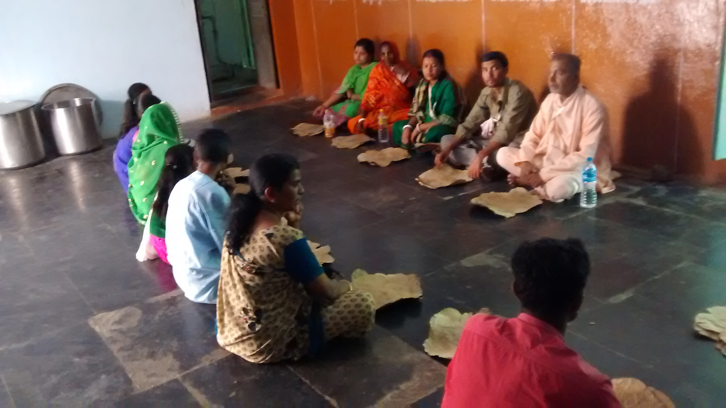
Notes:
We had lunch here at this Raghavendra Matha near Kishkintha.
It was very amazing...
We were about 20 and could not reserve the lunch..
When we came in, the head pujari said,
“Even if you came 2 min late, we could have closed.
And luckily there was a group of 25 people reserved for lunch but did not show up!
So, it is amazing that you all come. Pl have prasadam..”
This is only one side of the long row of us.
We also gave donation on behalf of ‘Gokul Bhajan” families!

Slide 26
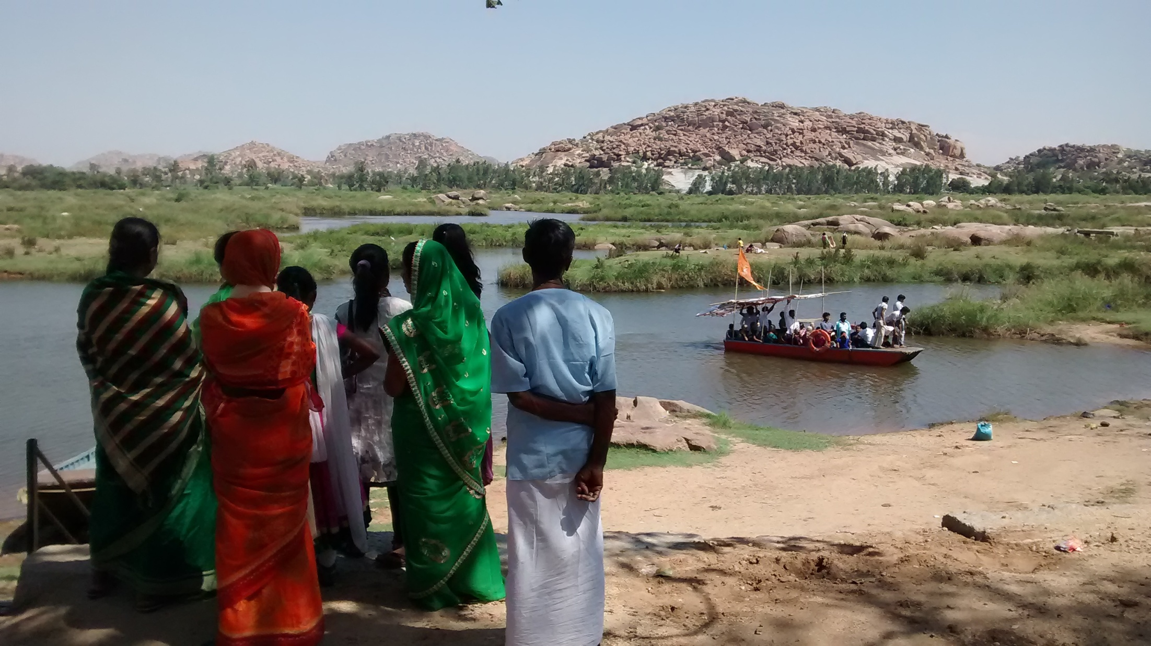

Slide 27
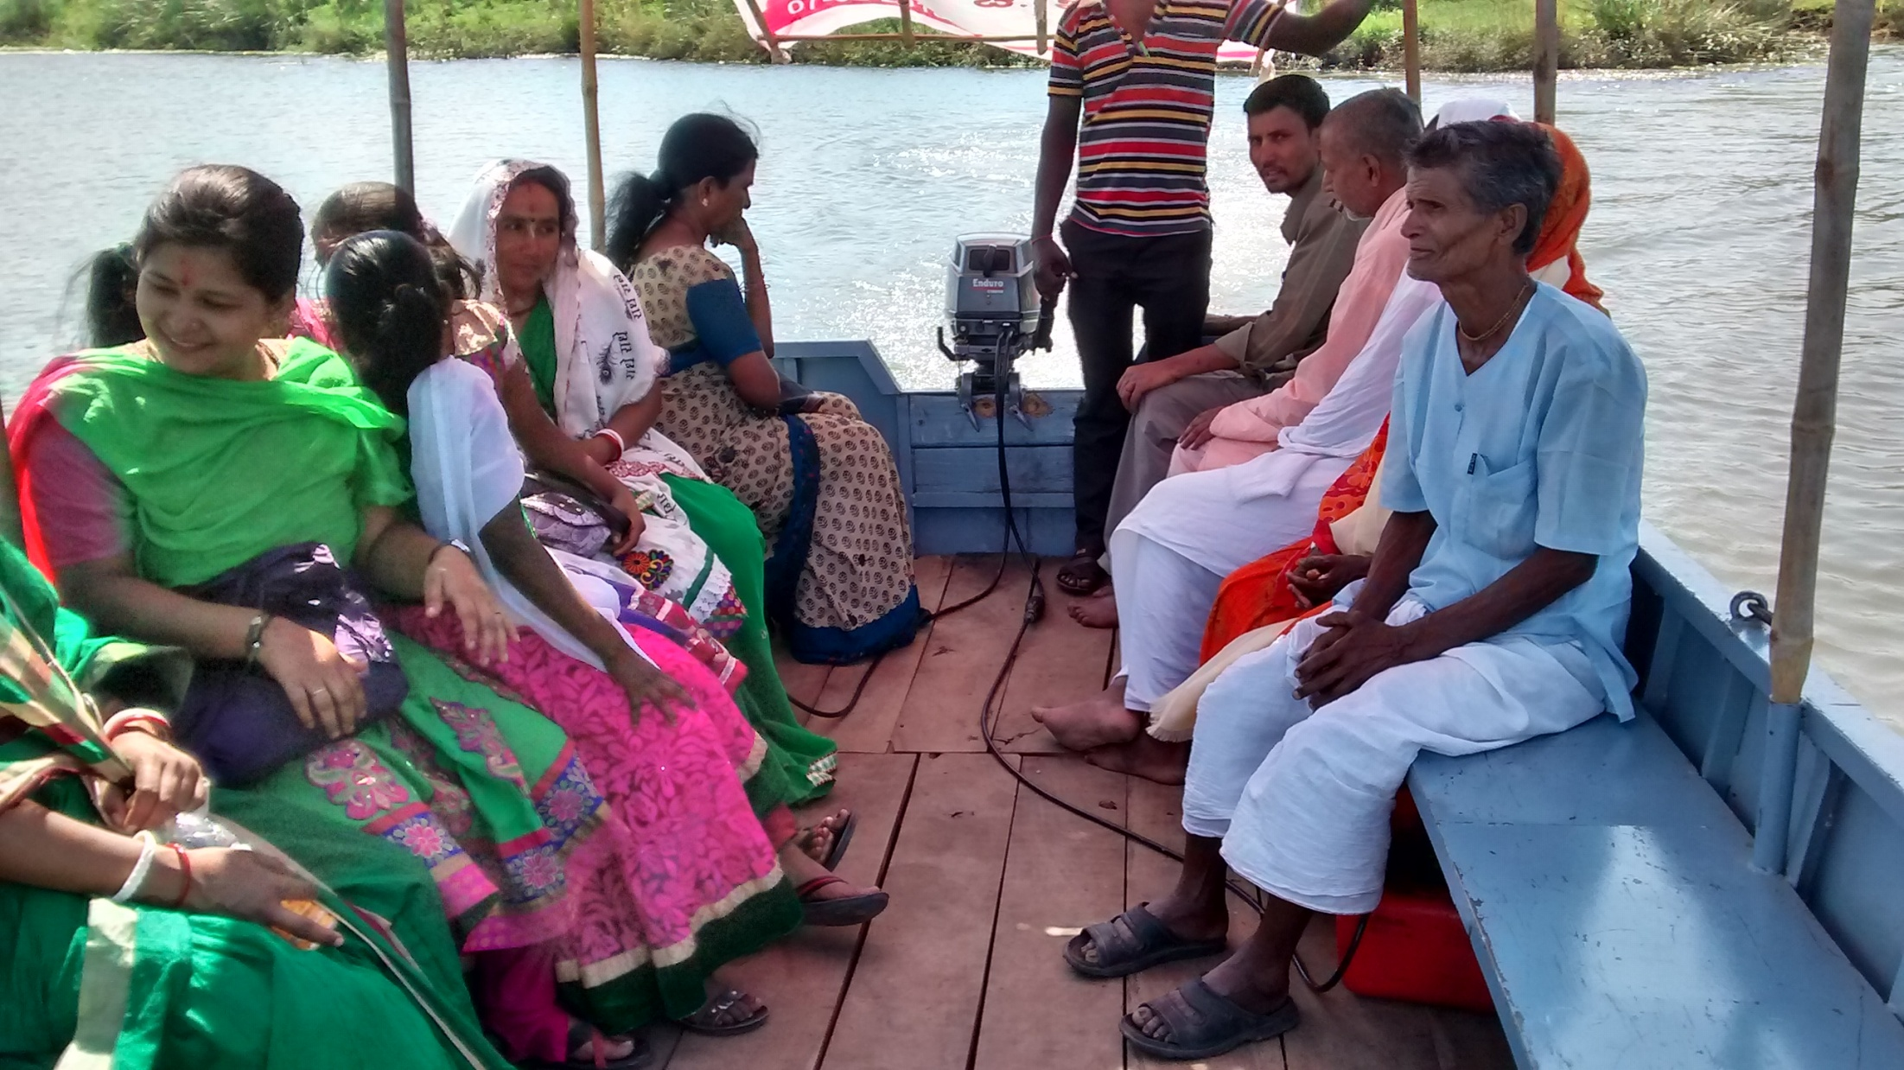

Slide 28
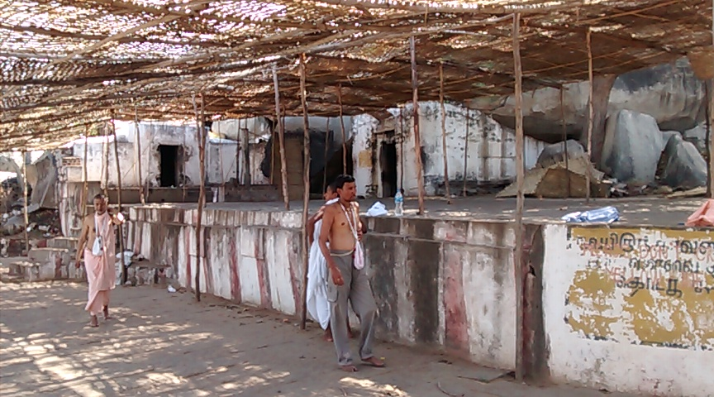
Before seeing the nava Vrindavan Samadis, we should visit these temples of Lord Vishnu, Lakshmi and Ugra Hanuman

Slide 29
Nava Vrindavan -
Jeeva Samadhis
(Nine)

Slide 30
Notes:
This is the deity of Madhvacharya:
Top as Hanuman
Bottom as Bhima

Slide 31
It was one my unforgettble place!
Tell the best things you liked?
Notes:
What is Manthralaya?
What is Jeeva Samadhi?
What is the name of the river that runs there? – Tungapadra
What are the 5 angas of Pancha-Mukha Hanuman? –
Hanuman,
Hayagriva,
Narasimha,
Garuda and
Varaha
What is Nava Vrindavan?
What was the name of incarnation of Prhalad in Dwapar Yuga? – Shanku-Karna

Slide 32
THANK YOU!
Hare Krishna!

